Slide 1
Question 1: Systematic AI Fund
Liam Andrew Beattie - 22562435

Slide 2
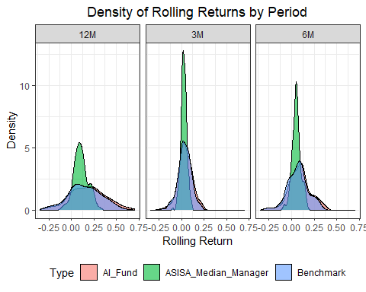
Purpose
Purpose of this work folder.
Ideally store a minimum working example data set in data folder.
Add binary files in bin, and closed R functions in code. Human Readable settings files (e.g. csv) should be placed in settings/
ggplot(combined_rolling %>% filter(!is.na(rolling_return)), aes(x = rolling_return, fill = Type)) + geom_density(alpha = 0.6) + # Semi-transparent density plots facet_wrap(~ Period) + # Facet by rolling period labs( title = "Density of Rolling Returns by Period", x = "Rolling Return", y = "Density", fill = "Type" ) + theme_bw() + # Clean theme theme( plot.title = element_text(hjust = 0.5), legend.position = "bottom" )

Slide 3
***
# Calculate rolling volatility for the benchmark (BM) BM_volatility <- calculate_rolling_volatility(BM$Returns, BM$date, window_size = 20) %>% mutate(Volatility_Regime = stratify_volatility_regimes(Rolling_Volatility)) # Merge volatility regimes with combined rolling returns combined_rolling <- combined_rolling %>% left_join(BM_volatility %>% select(date, Volatility_Regime), by = "date")

Slide 4
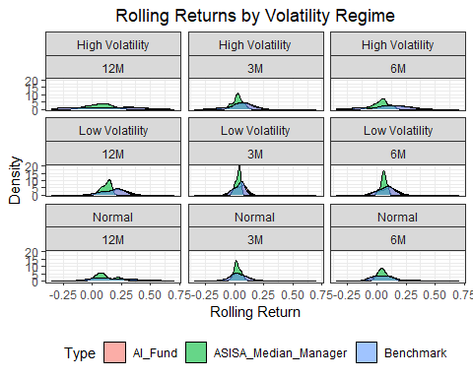
ggplot(combined_rolling %>% filter(!is.na(Volatility_Regime)), aes(x = rolling_return, fill = Type)) + geom_density(alpha = 0.6) + facet_wrap(~ Volatility_Regime+Period) + labs( title = "Rolling Returns by Volatility Regime", x = "Rolling Return", y = "Density", fill = "Type" ) + theme_bw() + theme(plot.title = element_text(hjust = 0.5), legend.position = "bottom")
## Warning: Removed 54 rows containing non-finite outside the scale range ## (`stat_density()`).

